Slide 1

Who am I:
Camilla Paoloni, Master Student in Bionformatics from the University of Bologna
I am here to do my Master Thesis project under the supervision of Gabriel Santpere

Slide 2
My Master Thesis Project:
Understanding the putative role of co-translational assembly in bHLH transcription factors
Camilla Paoloni, Master Degree Student in Bioinformatics
-University of Bologna
Notes:
This is the name of the project I am working on, which will also be the topic of my thesis.

Slide 3
1. INTRODUCTION

Slide 4
bHLH transcription factors:
Who are they and why are we interested in their study:
Family of TFs playing a crucial role in neuronal development and they are considered key to understand the risk of many human diseases.
Their structures share the presence of a common domain, the bHLH domain which is composed by:
- N-terminal basic α-helix
- A loop
- A more C-terminal α-helix
Notes:
Neurogenins (NEUROG) and other proneural factors belong to the bHLH family. Disruptions in these proneural factors, their target genes, and the DNA motifs they bind have been associated with various neuropsychiatric disorders. The bHLH domain typically consists of 40 to 60 amino acids, with the first 15 N-terminal residues forming the basic helix responsible for DNA binding.

Slide 5
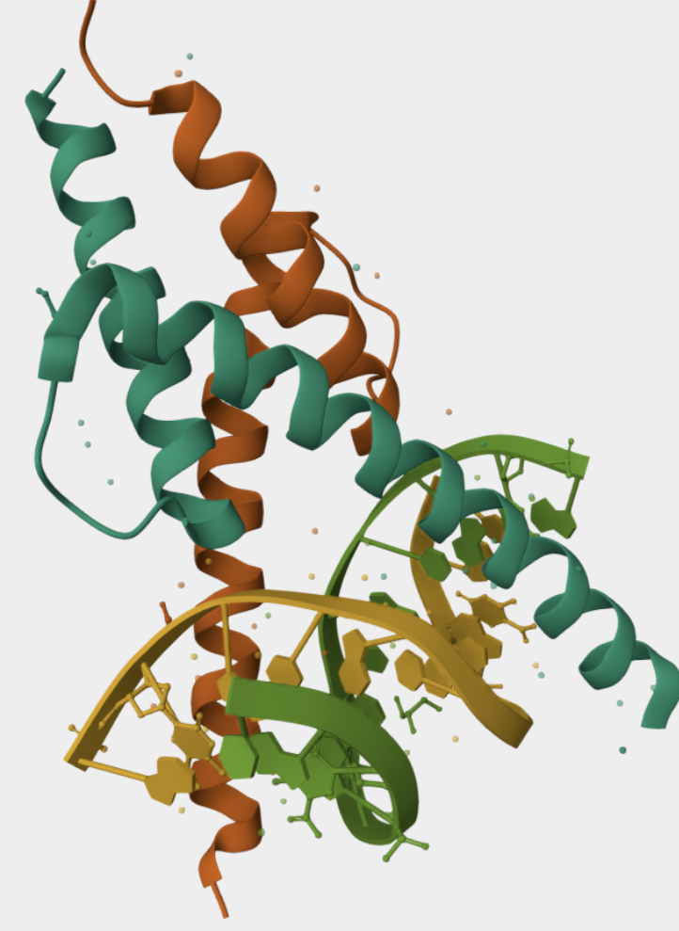
How do they activate transcriptions:
bHLH factors operate on the DNA, forming homodimers or heterodimers with other bHLH factors
bHLH dimers bind to E-boxes, hexanucleotides with conserved motif CANNTG
Classified based on sequence similarity in 5 classes: A,B,C,D,E (Atchley & Ledent)
Notes:
bHLH factors operate on the DNA forming homodimers or heterodimers with other bHLH factors and binding to specific motifs called E-boxes, which are hexanucleotides of the form CANNTG, composed of two CAN half sites on opposed strands.
The basic domain composed by around 15-20 amino acids is responsible of contacting the DNA) The two alpha after the basic domain confer the platform for the formation of the bHLH dimers.
bHLH molecules were initially broadly classified by Murre et al. using a mixture of qualitative criteria in six classes
Alternative classification systems have been proposed based on aminoacid sequence alignments, forming classes A, B, C, D and E. tThis sequence-based classification is the one I adopted in my project and that will be shown in the plots in the next slides.

Slide 6
2. AIMS OF THE PROJECT

Slide 7
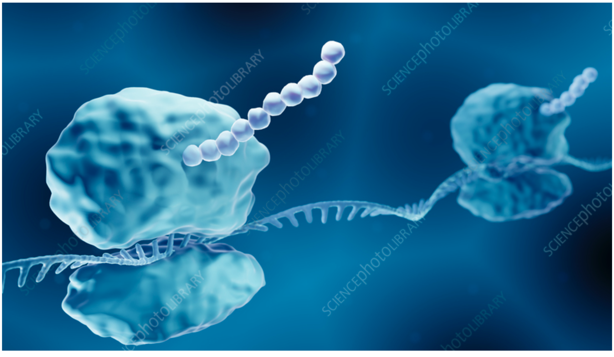
The aim of my project:
Verify the hypothesis that the choosing of partner by bHLH factors is influenced by co-translational assembly (Co-TA).
Co-TA is a process by which protein complexes are made while subunits are translated, imposing evolutionary constraints in the position of the interaction domains
Elegant Lines Pitch Deck // 2021
Notes:
We aim to test the hypothesis that the selection of dimerization partners by bHLH factors is influenced by co-translational assembly (Co-TA). Co-TA is a process in which protein complexes are formed as their subunits are being translated, imposing evolutionary constraints on the positioning of interaction domains within proteins. Specifically, the location of the bHLH dimerization domain within the coding sequence may impact the efficiency of Co-TA.

Slide 8
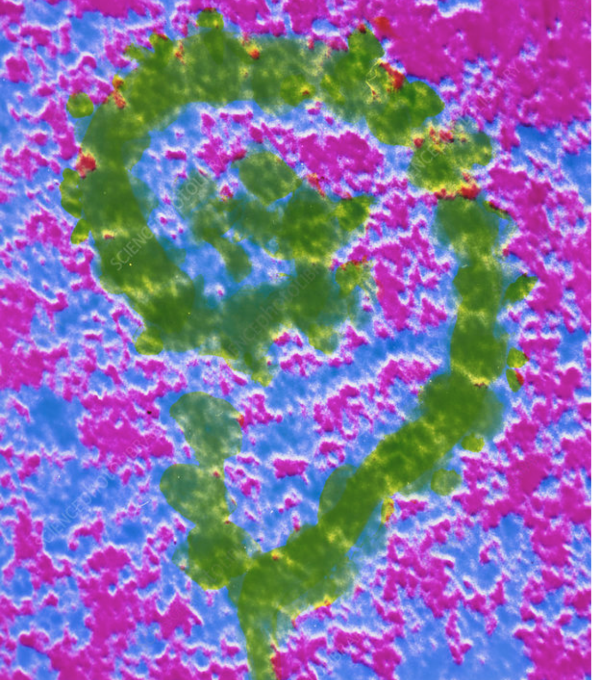
How Co-TA works:
N-terminal bHLH domain → Favors Co-TA Earlier interaction between nascent polypeptides
C-terminal bHLH domain → Limits Co-TA Delays dimerization until translation is complete
Objectives:
Analyze bHLH domain positioning across species.
Identify evolutionary trends in domain placement.
Assess whether Co-TA is an evolutionarily favored mechanism in the bHLH family.
Notes:
For example, a more N-terminally positioned bHLH domain is expected to facilitate Co-TA by allowing earlier interaction between nascent polypeptides, whereas a more C-terminal position may hinder this process by delaying dimerization until translation is complete.
To investigate this, we will analyze the relative position of the bHLH domain within the coding sequence of various bHLH factors across the phylogenetic tree, identifying evolutionary trends in domain positioning. This study will provide insights into whether Co-TA is an evolutionarily favored or disfavored mechanism in the bHLH family, shedding light on how translational dynamics shape protein-protein interactions.

Slide 9
3. RESULTS

Slide 10
Data from the Human TF Database (Lambert et al.)
Notes:
We began our analysis using human data retrieved from **BioMart (Ensembl Genes 113)**, focusing on the **amino acid sequence conservation** of the **bHLH domain** across all isoforms of the **112 human bHLH transcription factors (TFs)**. Our goal was to assess the consistency of this data with the **Human TF Database**, as curated by **Lambert et al.**, which represents the **state-of-the-art reference** for the sequence conservation of the bHLH family.
To achieve this, we compared the sequence conservation patterns extracted from **BioMart** with those documented in the **Human TF Database**, ensuring that both datasets provide **aligned and reliable information**. This step is crucial for validating the accuracy and completeness of publicly available datasets and determining whether BioMart can serve as a reliable source for future large-scale analyses of bHLH transcription factors.

Slide 11
Our team
Jenna Doe
Tommy Lean
Susan Bones
You can speak a bit about this person here
You can speak a bit about this person here
You can speak a bit about this person here
Notes:
This plot is the same as the one shown in the previous slide, but here I have generated it using the start and end positions of the bHLH domain as recorded in the InterPro database. InterPro is a comprehensive resource that provides functional analysis of protein sequences, classifying them into families and predicting the presence of conserved domains and functional sites.
By aligning the bHLH domain sequences and comparing them with the reference data published by Lambert et al., I confirmed that my sequence alignment is consistent with the established literature. This validation allowed me to confidently proceed with the analysis using the data retrieved from InterPro and BioMart, as these databases can be considered reliable sources for studying the sequence conservation of the bHLH transcription factor family.

Slide 12
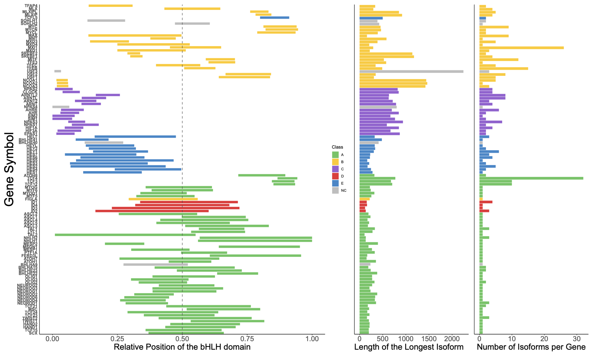
Problem
Notes:
In this plot, we visualize the relative position of the bHLH domain across the 112 human transcription factors (TFs), mapped onto the longest isoform of each TF. The plot also represents the total sequence length for each TF, providing a clear proportional view of the bHLH domain's position within the full protein sequence. Given that the bHLH domain typically consists of 40 to 60 amino acids, this visualization helps contextualize its placement within different TFs.
Additionally, the plot includes information on the number of isoforms per gene, which has recently been leveraged to investigate how alternative splicing influences the positional variability of the bHLH domain across different isoforms of the same gene.
The color coding in this plot represents classifications based on amino acid sequence alignment. Notably, the plot shows that the position of the bHLH domain remains relatively consistent within different sequence-based classes, suggesting a degree of evolutionary constraint on domain positioning within specific TF families.

Slide 13
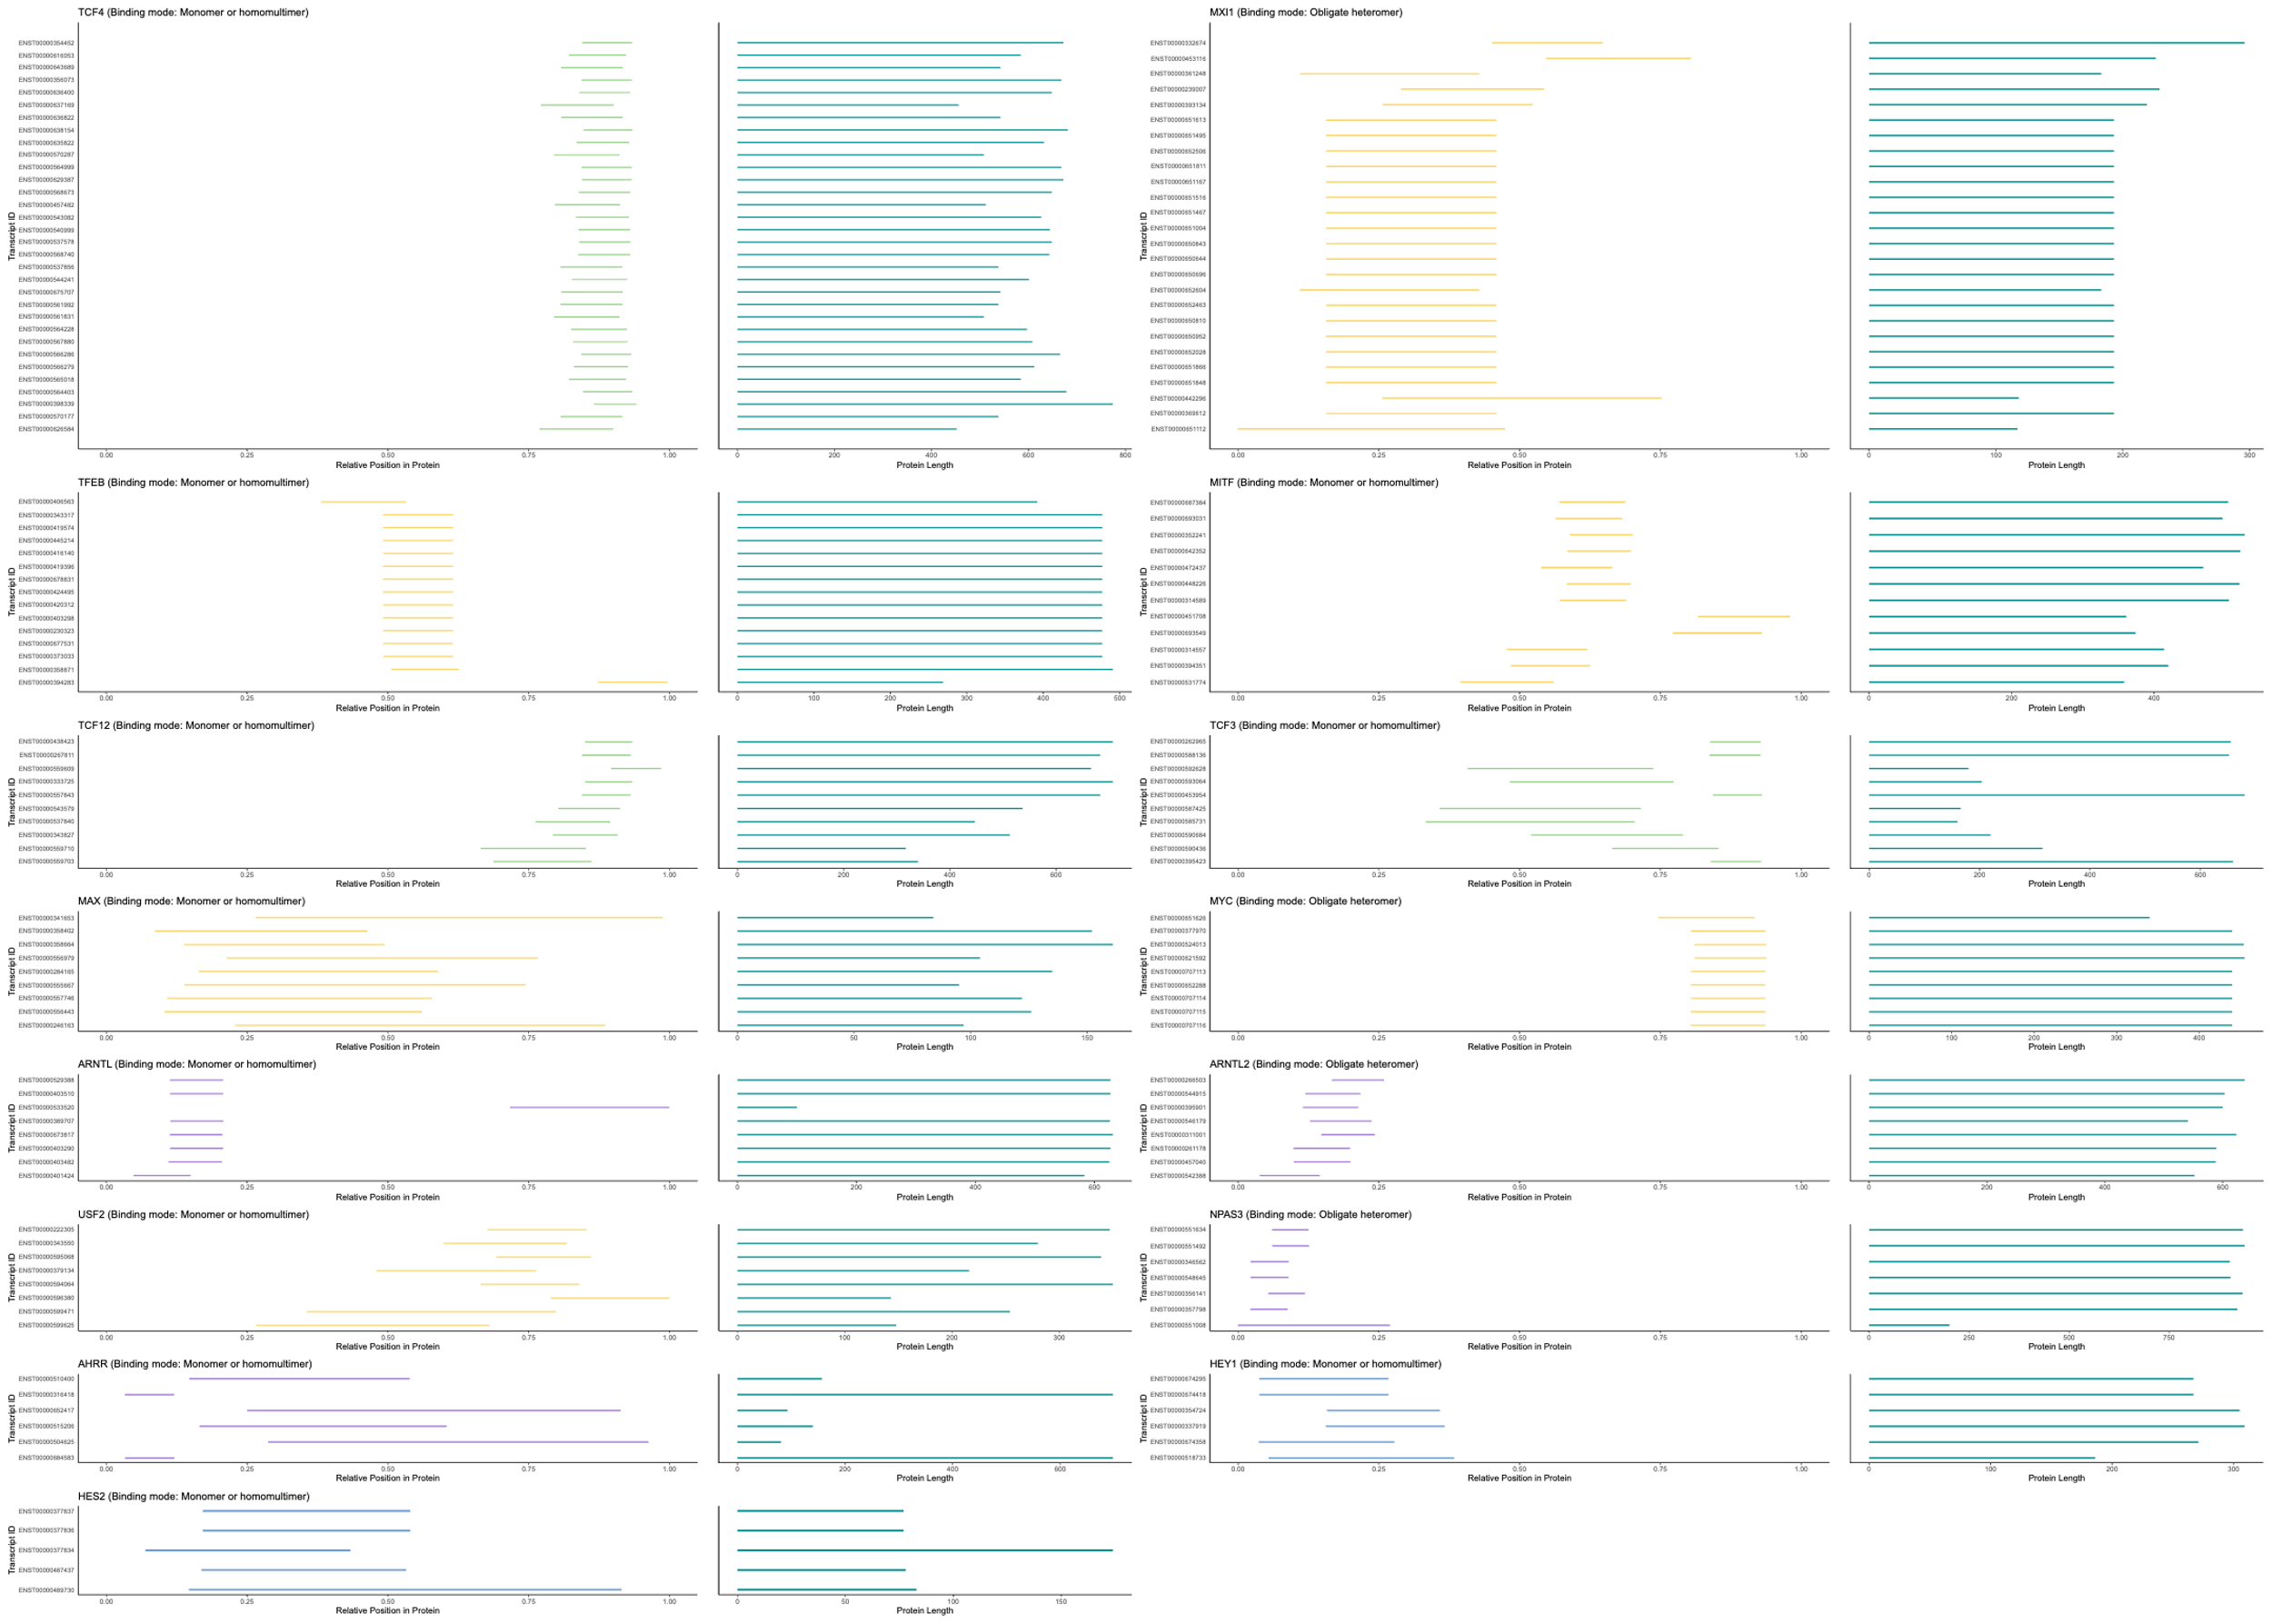
Product overview
Mercury
Jupiter
Venus
Saturn
Mars
Neptune
Mercury is the closest planet to the Sun
Jupiter is the biggest planet of them all
Venus is the second planet from the Sun
It’s composed of hydrogen and helium
Despite being red, Mars is actually a cold place
Neptune is the farthest planet from the Sun
Notes:
Recently, I conducted the same analysis for each of the 112 transcription factors (TFs) of interest, focusing on how the relative position of the bHLH domain is conserved across their different isoforms. The results revealed significant variability among different genes, highlighting diverse patterns of domain positioning.
Starting with TCF4, the gene with the highest number of isoforms, I observed a strong conservation of the bHLH domain's relative position across its isoforms. TCF4 is a key transcription factor involved in numerous developmental processes, making this conservation particularly noteworthy.
In contrast, TFEB presents an intriguing case: while most of its isoforms have a similar overall length, theshortest isoform exhibits a complete shift of the bHLH domain toward the C-terminal end of the protein caused by the alternative splicing. A comparable pattern is observed in the ARNTL gene, where one isoform deviates significantly from the others in domain positioning.
Another interesting case is MITF, which shows a relatively variable positioning of the bHLH domain among its isoforms, suggesting greater flexibility in how alternative splicing influences its function. Finally, AHRR provides a striking example of how alternative splicing directly affects the position of the bHLH domain, emphasizing the role of transcript diversity in modifying protein structure.
These findings suggest that while some TFs maintain strict conservation of domain positioning, others exhibit isoform-dependent variations, potentially influencing their regulatory functions.

Slide 14
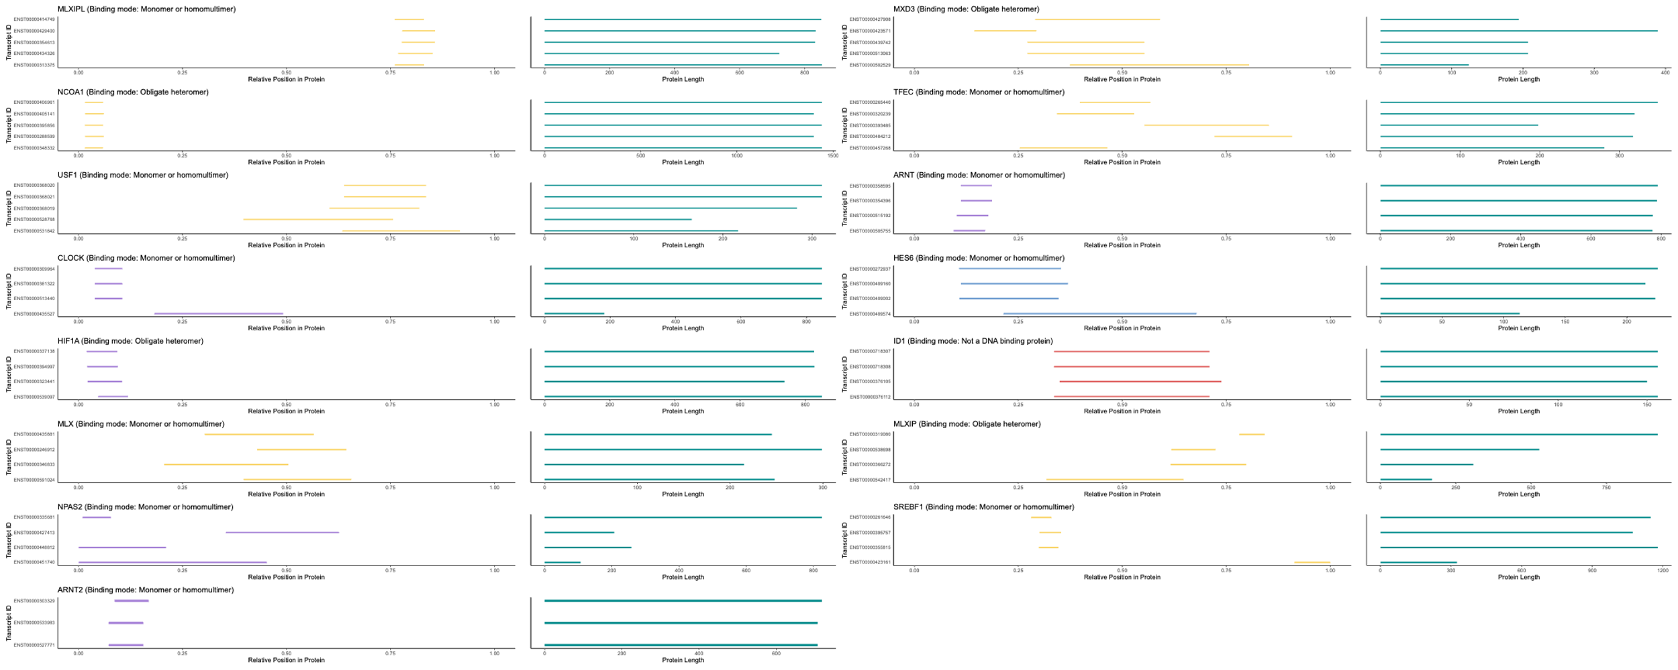
SWOT analysis
Strengths
Opportunities
Weaknesses
Threats
S
O
Venus is the second planet from the Sun
Jupiter is the biggest planet of them all
W
T
Despite being red, Mars is a cold place
Saturn is a gas giant and has several rings
Notes:
Shifting our focus to genes with a moderate number of isoforms (between 3 and 5), we observe that, in many cases, the bHLH domain position remains highly conserved across isoforms. However, in specific genes, alternative splicing clearly influences domain positioning, leading to noticeable shifts.
in TFEC, CLOCK, and
For instance, in MLXIP, a distinct pattern emerges: the shorter the isoform, the more N-terminal the bHLH domain appears. This suggests a possible length-dependent constraint on domain positioning, where alternative splicing events predominantly affect the C-terminal portion of the protein, leaving the N-terminal region and bHLH domain relatively intact.
A particularly interesting case is NPAS2, where alternative splicing leads to clear shifts in the bHLH domain’s position, further supporting the idea that splicing variation can significantly alter protein structure.
These observations highlight how, in some transcription factors, domain positioning is tightly regulated, while in others, alternative splicing plays a key role in modulating functional architecture, potentially impacting protein interactions and activity.

Slide 15
4. FUTURE PERSPECTIVES

Slide 16
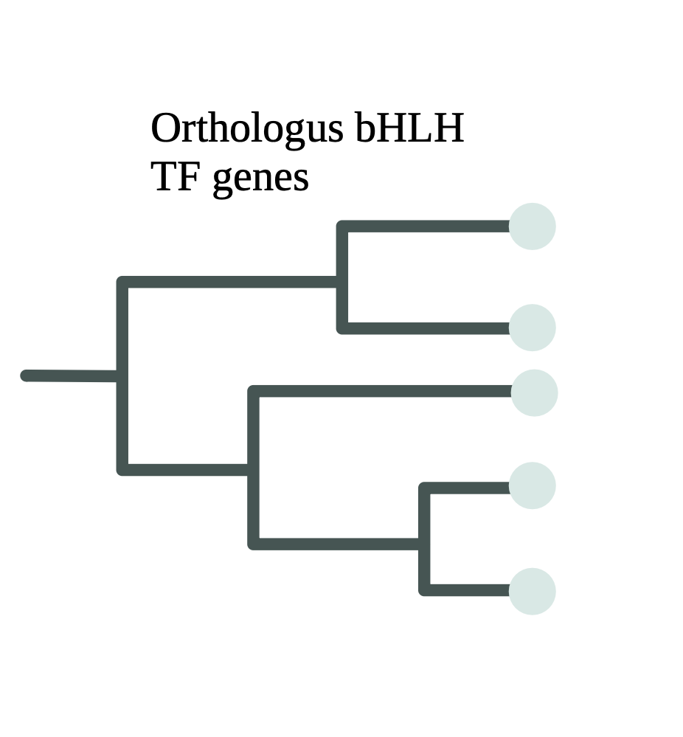
Future Perspectives:
Evaluate the relative position of the bHLH domain in orthologous genes across the phylogenetic tree to identify potential conservation patterns and verify the initial hypothesis of cotranslational assembly (Co-TA).
Notes:
In the next steps of this analysis, we will investigate whether the relative position of the bHLH domain is conserved across orthologous genes in different species. By mapping these positions onto a phylogenetic tree, we aim to identify potential evolutionary patterns of conservation. If the domain consistently appears in the same relative position, it would suggest the presence of functional or structural constraints that have been maintained over time, supporting the hypothesis of a Co-TA mechanism within this transcription factor family.
Additionally, I would greatly appreciate any suggestions regarding the choice of species to include in this analysis, as well as recommendations for suitable tools to perform the phylogenetic reconstruction. Finding the right balance between species diversity and data availability will be crucial to ensuring a robust and meaningful interpretation of the results

Slide 17
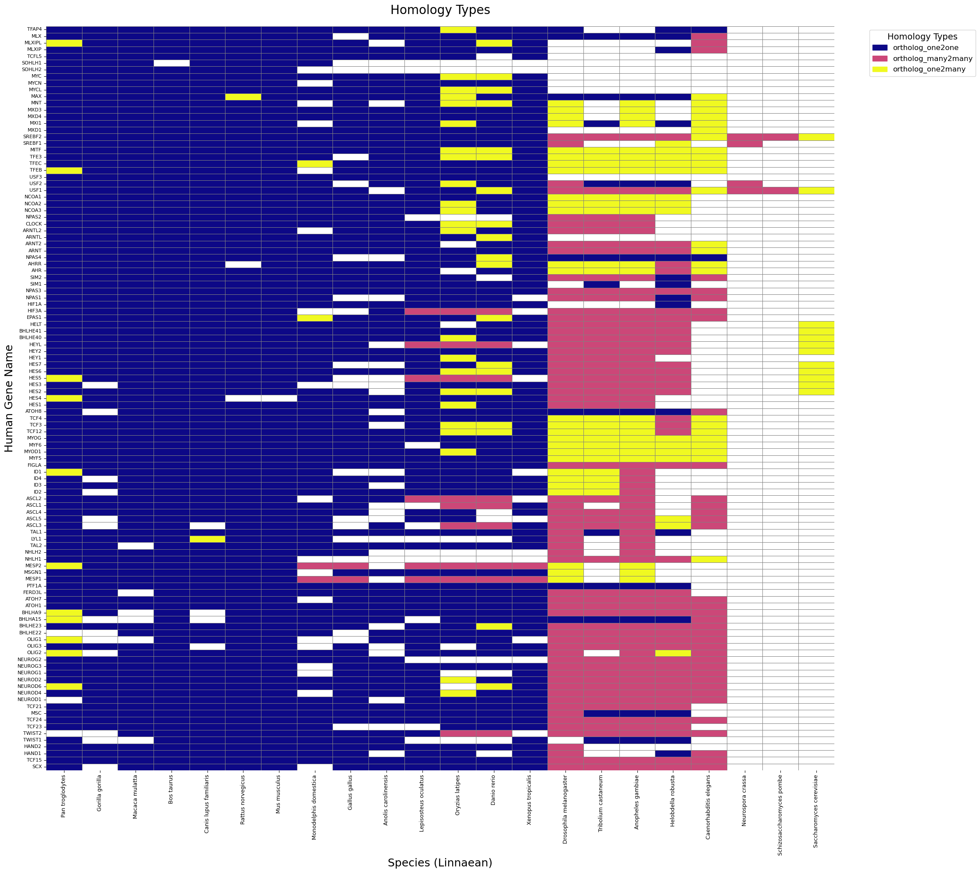

Slide 18
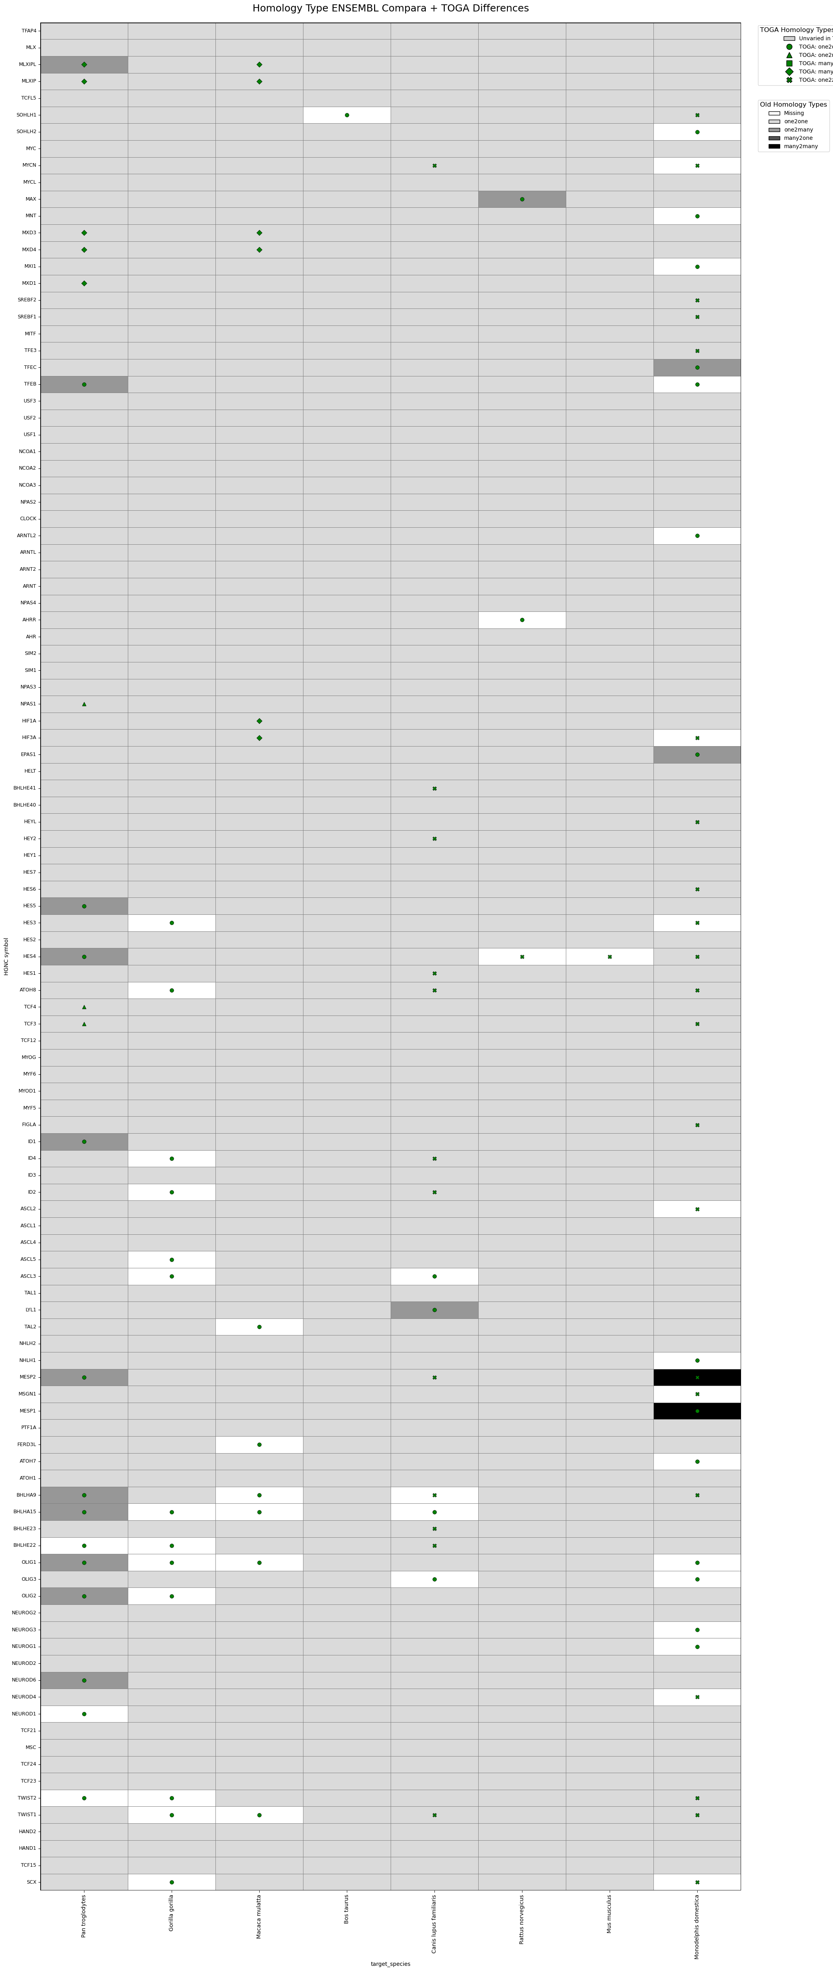

Slide 19
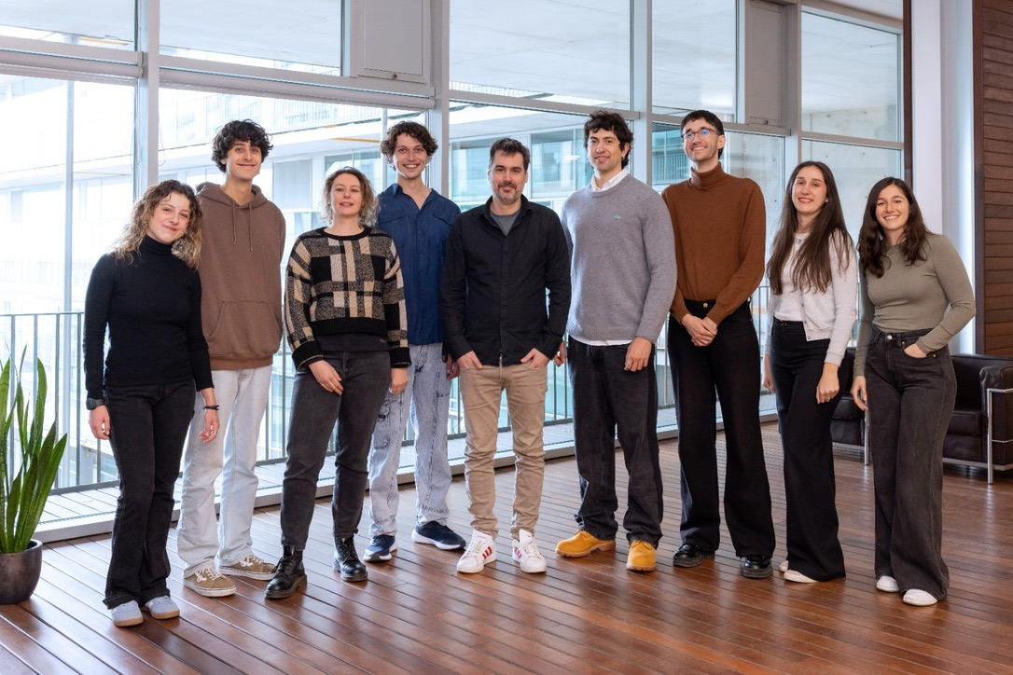
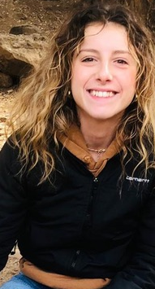
Thank you for your attention !
I’d love to hear your thoughts and suggestions if you have any

